Slide 1
Kamlesh Bhardwaj
Capstone Project - Fitbit
Consumer Behavior Analysis

Slide 2

Acknowledgement
Under the mentorship of Sir Rishikesh Konapure, I analyzed Fitbit Fitness Tracker App data, focusing on minute-level data from 30 users. I utilized Python and Pandas for data cleaning, transformation, and analysis, uncovering trends in user behavior. The diverse dataset, sourced via Amazon Mechanical Turk, offered rich insights into daily activity patterns. My deliverables included a concise summary, detailed data source descriptions, cleaning documentation, visualizations, key findings, and high-level content insights, providing a comprehensive understanding of user engagement and fitness trends.

Slide 3
Project Overview
The project's basic overview is that we have various user data sets monitoring various values, such as total calories consumed, total steps taken, heart rate, sleep records, daily activity, hourly data, and minutes data, all of which are necessary to track each user's minute details and maintain their fitness record. However, each data collection required cleaning, some needed to be combined, and we wanted to provide an overview of each user's data sets using visualization

Slide 4
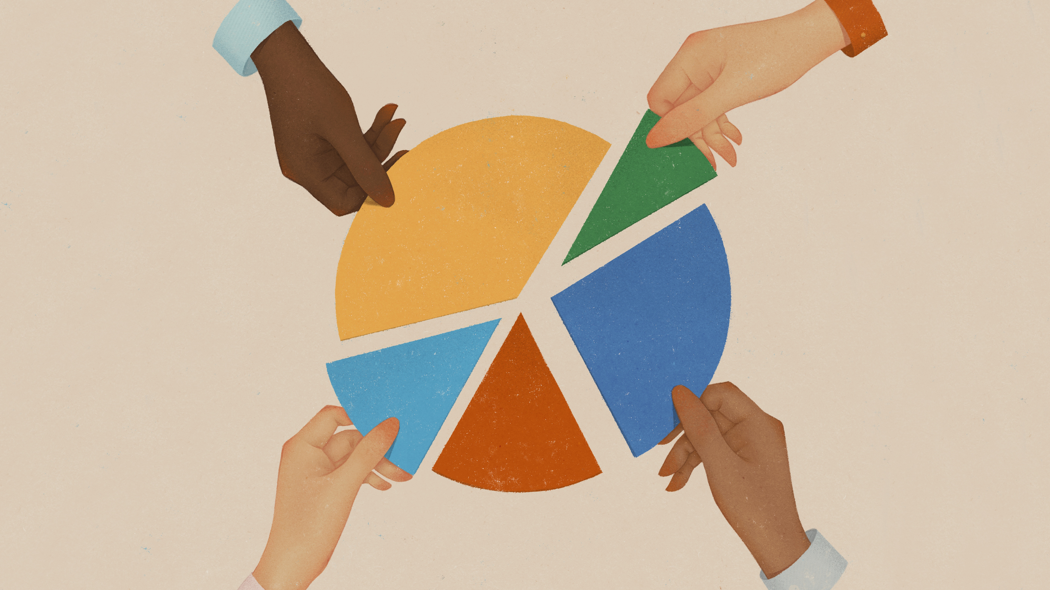
DATA OF USERS
Sleep & Heart record
Daily Activity
Minute_Data
Hourly Data

Slide 5
Cleaned Data Sets Visualization
1.DailyActivity
2.Hourly_Data
3.Minute_Data
4.Sleep_Record
5.Heart_Rate

Slide 6
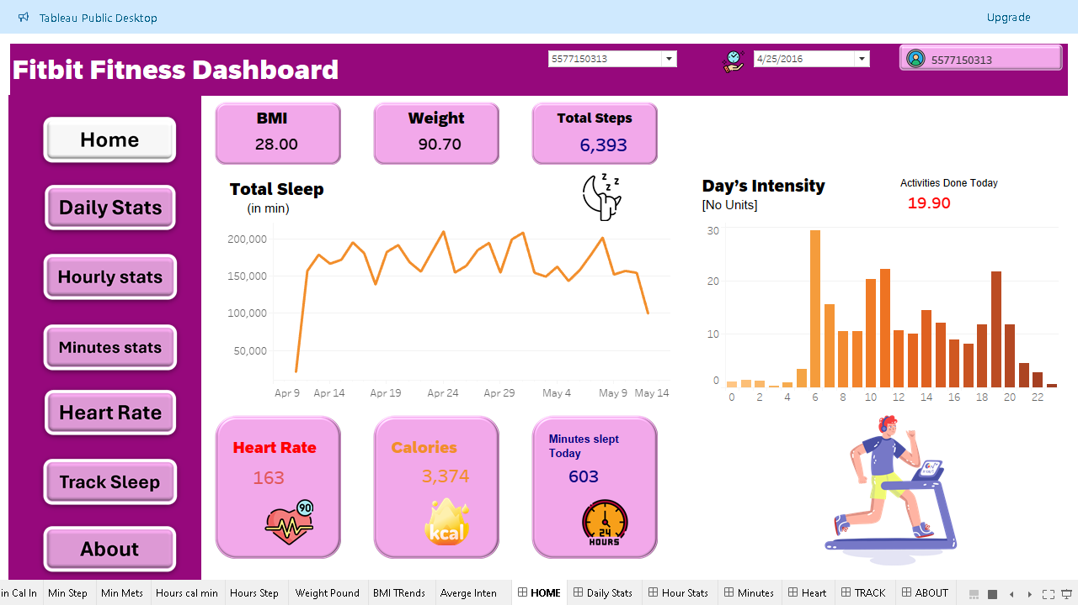
Home

Slide 7
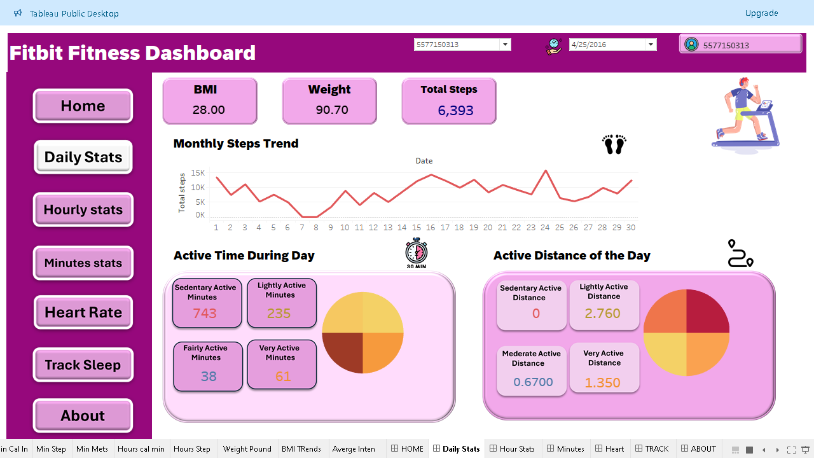
Daily Stats

Slide 8
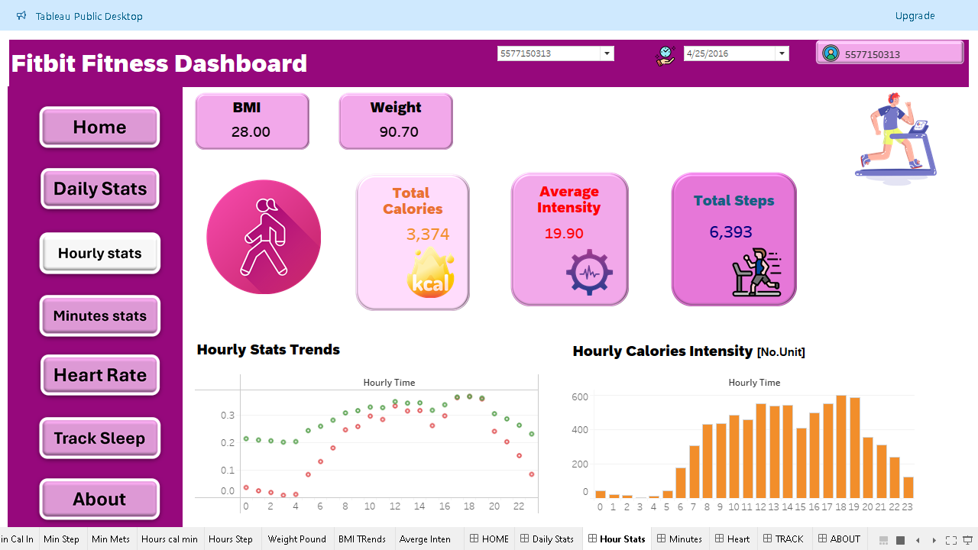
Hourly Stats

Slide 9
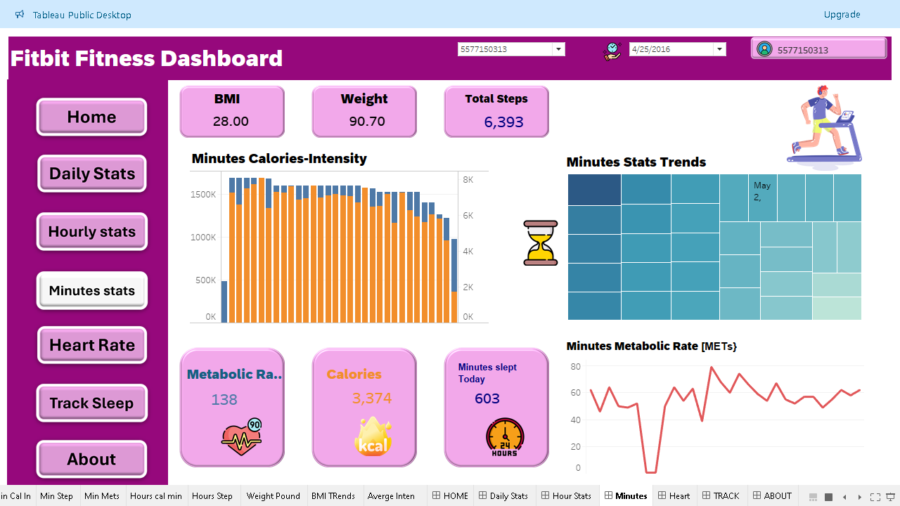
Minutes Stats

Slide 10
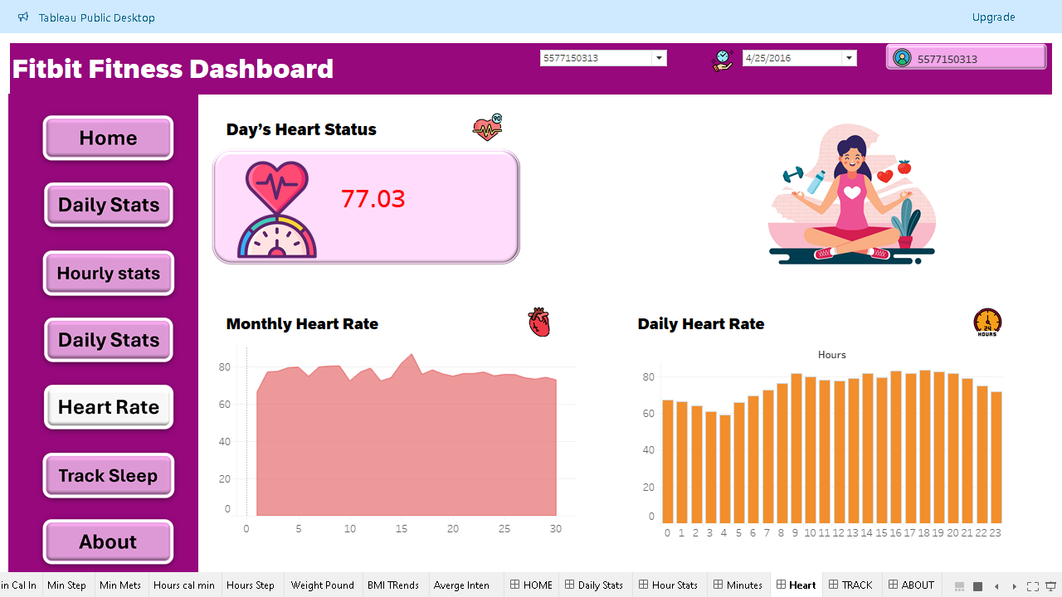
Heart Rates

Slide 11
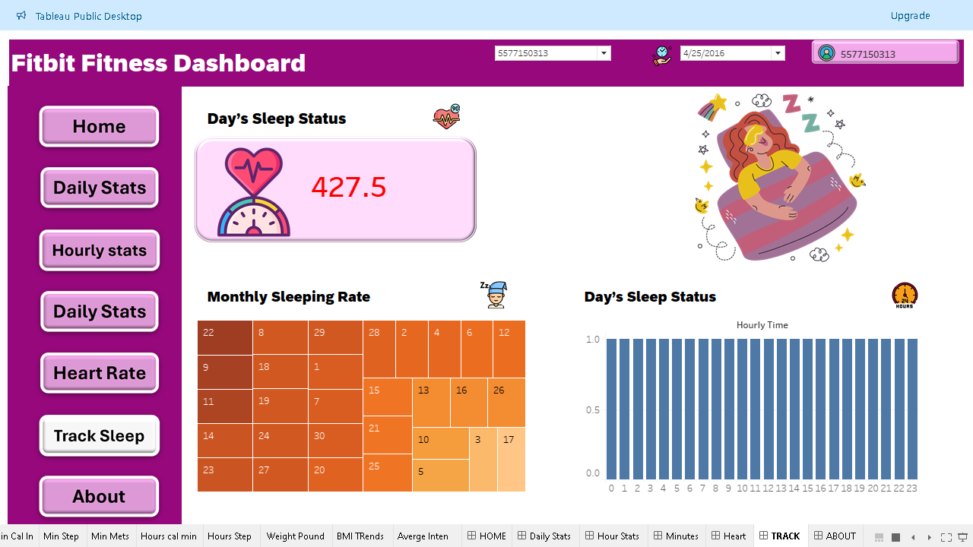
Track Sleep

Slide 12
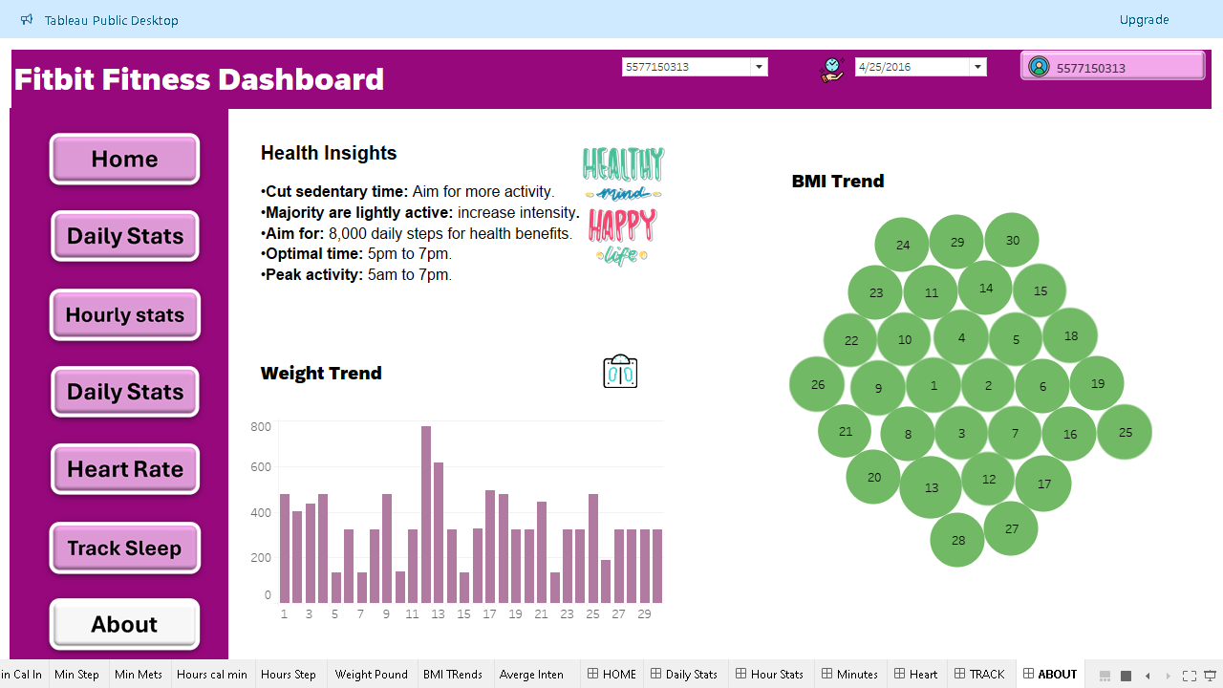
About

Slide 13
Cleaned Data Sets OverView
1.DailyActivity
2.Hourly_Data
3.Minute_Data
4.Sleep_Record
5.Heart_Rate

Slide 14
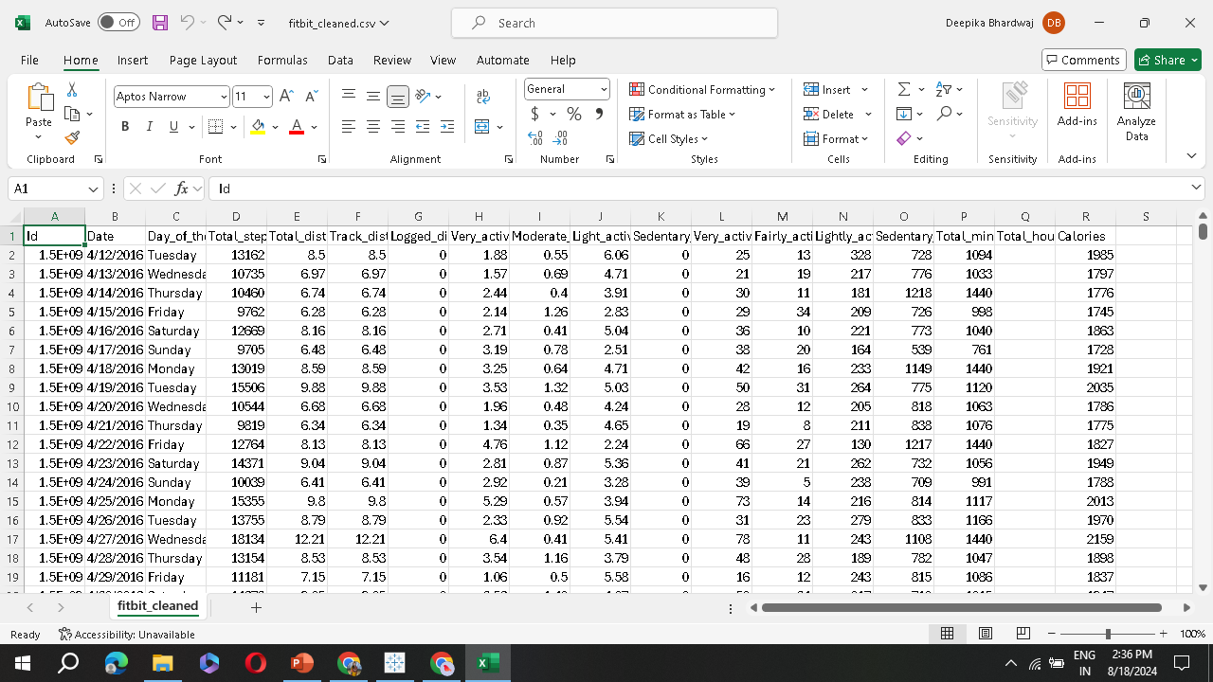
Daily Activity

Slide 15
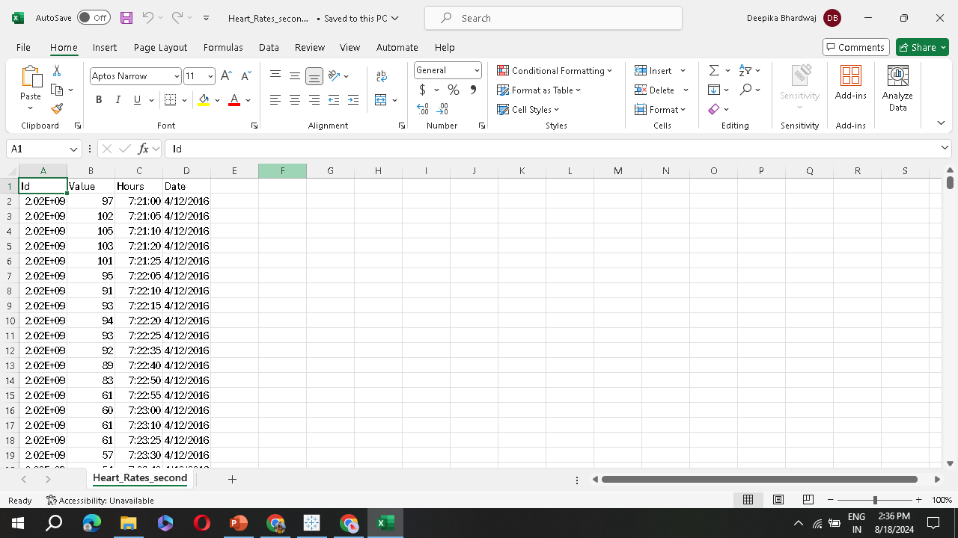
Heart Data

Slide 16
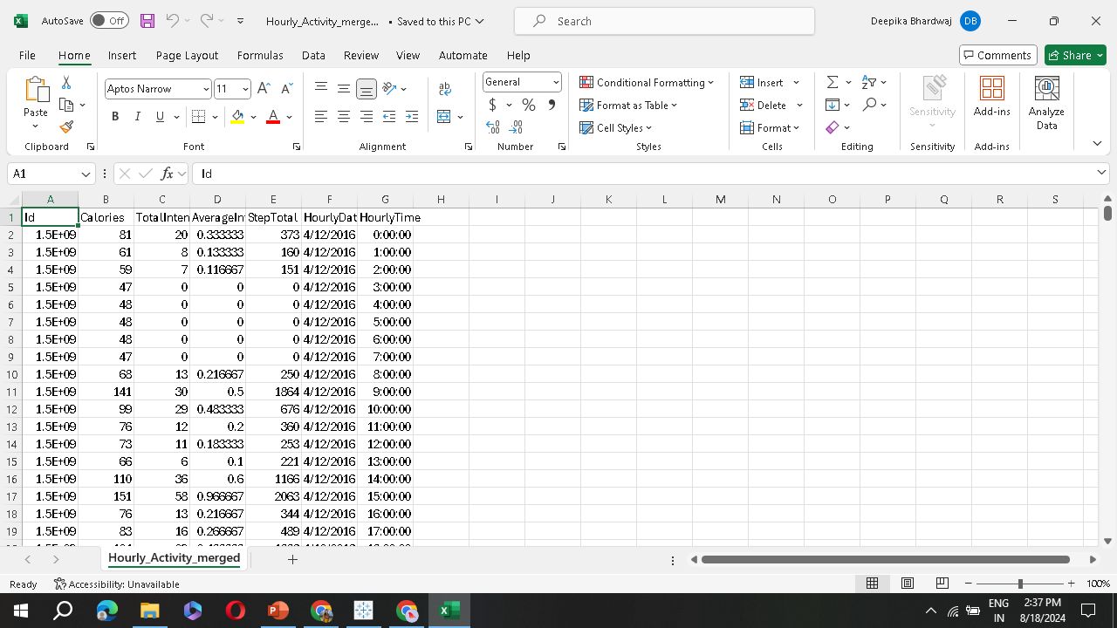
Hourly Data

Slide 17
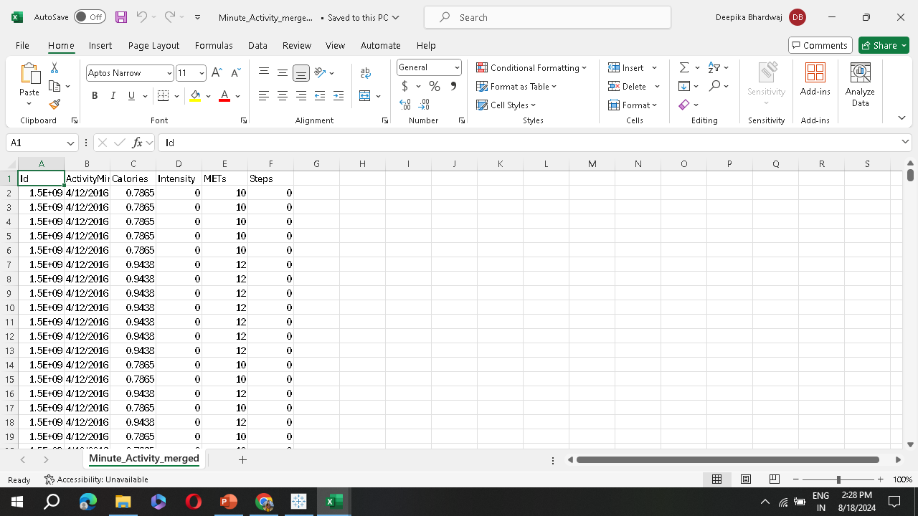
Minutes Activity

Slide 18
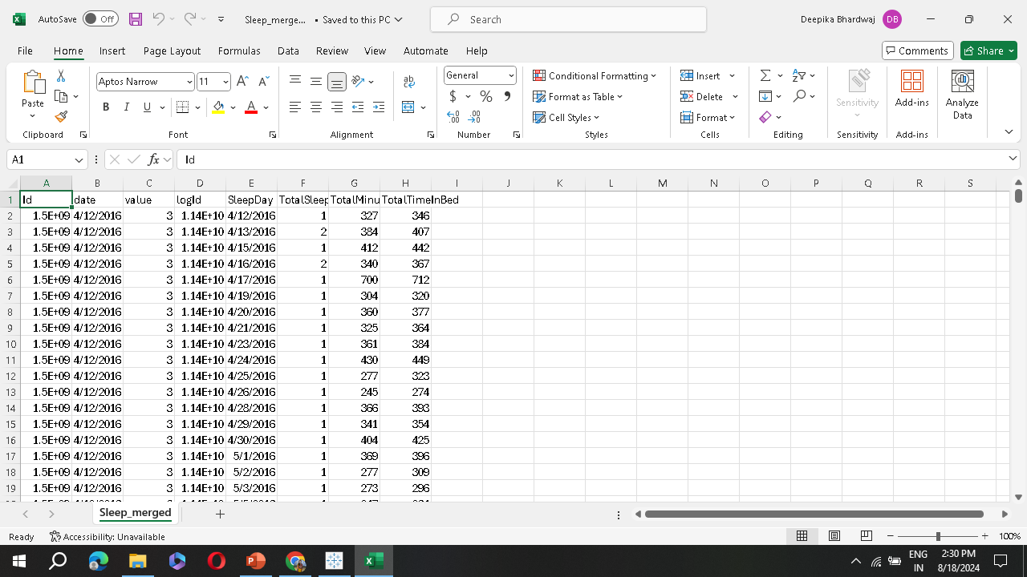
Sleep

Slide 19
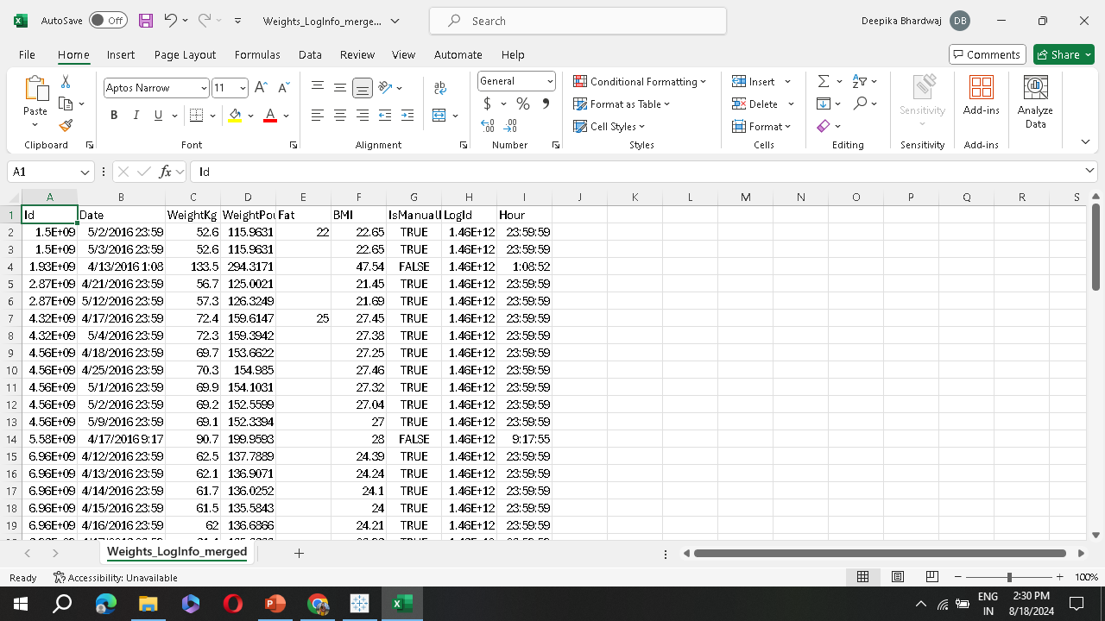
Weights

Slide 20
LINKS
1 FitbitProject
https://colab.research.google.com/drive/1ZRilbQ1F2pxMT8IILoN2b8MgL_h6uivF?usp=sharing
2 Minutes activity
https://colab.research.google.com/drive/1xPJg8ZYveeISXps-IwQPSvceFkqRgWJV?usp=sharing
3 Weight_Heart
https://colab.research.google.com/drive/164F1V4ISnUESRCVADOteciJXHU6qttMm?usp=sharing
4 Sleep
https://colab.research.google.com/drive/14MqswUb1FQ8gUNPcKR7KInZ2g75MkSAz?usp=sharing5
https://colab.research.google.com/drive/13gcWDnlXAq-cfenBfshQiPrxrckhb5Ah?usp=sharing
5 Hourly Activity

Slide 21
TABLEAU LINKS
https://public.tableau.com/app/profile/kamlesh.bhardwaj/viz/FitBitFitnessProject/HOME

Slide 22
Thank you

